Slide 1



Slide 2
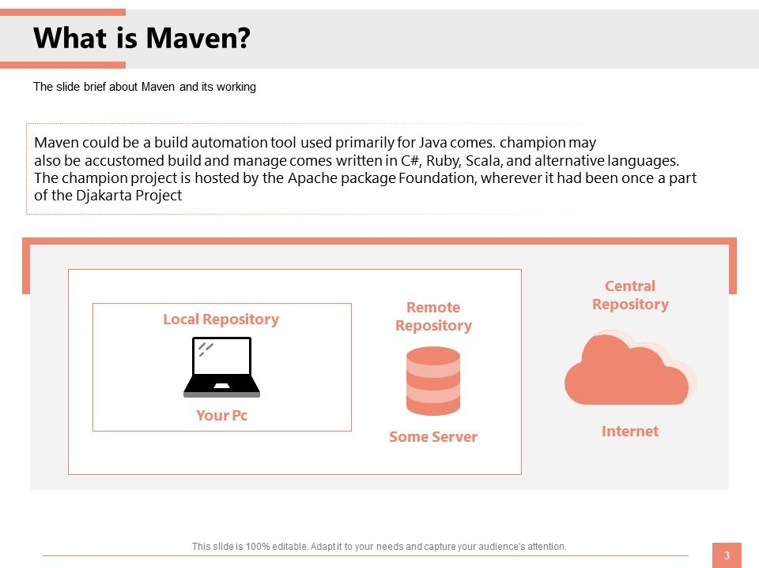

Slide 3
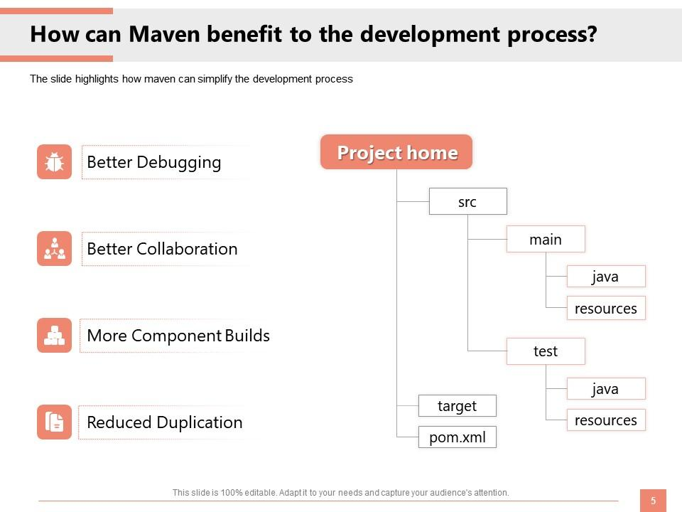

Slide 4
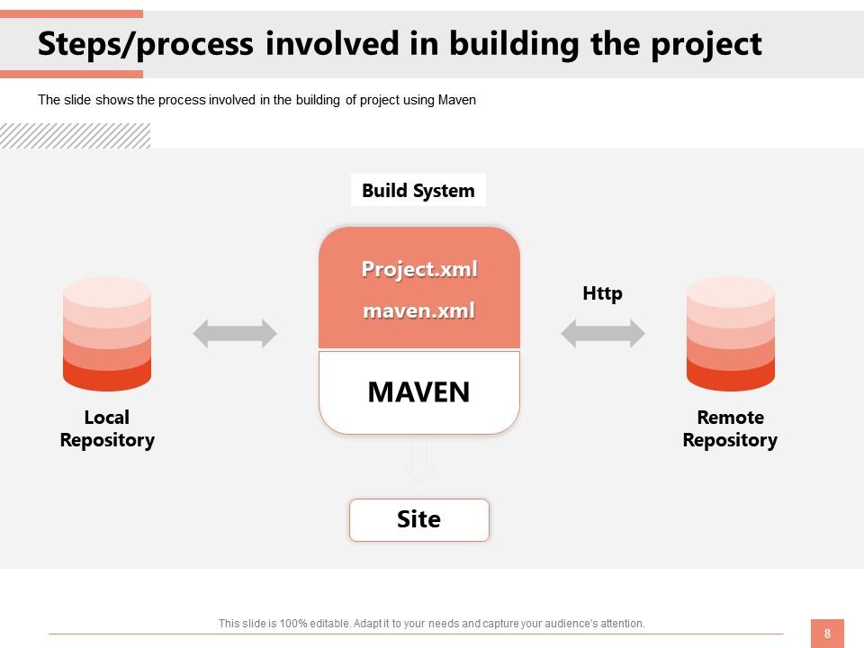

Slide 5
Life cycle of maven
validate - validate the project is correct and all necessary information is available
compile - compile the source code of the project
test - test the compiled source code using a suitable unit testing framework. These tests should not require the code be packaged or deployed
package - take the compiled code and package it in its distributable format, such as a JAR.
verify - run any checks on results of integration tests to ensure quality criteria are met
install - install the package into the local repository, for use as a dependency in other projects locally
deploy - done in the build environment, copies the final package to the remote repository for sharing with other developers and projects.

Slide 6
THANK YOU

